Slide 1
AI-Driven System for Classifying Skin Diseases from Images
Presented by
Damian Williams
Sri Yalamanchili
Maddie Sidwell
Savannah Ostermeyer
Manuel Nieves

Slide 2
Problem Statement
Current Situation:
Melanoma, deadly skin cancer, has increased in incident rates for several decades
Problem:
Melanoma needs to be detected early to increase survival rates
Proposal:
AI Driven Skin Classifying Diseases from Images
Predicted Outcome:
Patients will receive accurate diagnosis from uploaded images resulting in earlier diagnosis of melanoma

Slide 3
Functional Requirements
Collect demographics, symptom descriptions, and allow users to upload lesion images.
Store medical rules, disease information, and apply reasoning or machine learning to support differential diagnosis with confidence scores.
Present possible diagnoses, next steps, and red-flag alerts, while generating patient reports and storing diagnostic history.
Integrate new knowledge and retrain models on updated datasets.
User account system: Allow patients and dermatologists to create accounts for uploading and saving cases.

Slide 4
Nonfunctional Requirements
Intuitive interface for patients and dermatologists, accessible via web or mobile
Achieve ≥85–90% classification accuracy and generate diagnoses within seconds, handling multiple inputs efficiently
Ensure HIPAA/GDPR-compliant secure data handling and provide explanations highlighting key features of the diagnosis

Slide 5
Technology
· Programming Language: Python
· Deep Learning Framework: PyTorch (using a ResNet50-based convolutional neural network)
· Dataset: HAM10000 (Human Against Machine with 10,000 training images of skin lesions)
· Development Environment: Visual Studio Code (VS Code)
· Front-End Web Technologies: HTML and CSS for user interface design (responsive for mobile and desktop)
· Database: MongoDB
· Cloud Service Provider: Google Cloud Services
· Backend Framework: FastAPI (Python)
Colab: Train AI

Slide 6
Expert System
Uses Gemini to handle conversational interaction,
Allowing the system to respond in plain english or easy to read
Integrates a custom Ai model trained on the HAM10000 dataset
provides image-based diagnostic support
Combines Ai prediction with hard-coded rule based-reasoning (duration, symptoms, risk factors)
generate risk severity
Expert system is supposed to simulate a dermatologist

Slide 7
Task Accomplished
Frontend
Homepage
Upload page
Reports
About
Login page
Importing and Preprocessing the HAM10000 Dataset
Setting up the virtual environment
Some Disease Classes up to 80% accuracy
Expert system chatbot conversation

Slide 8
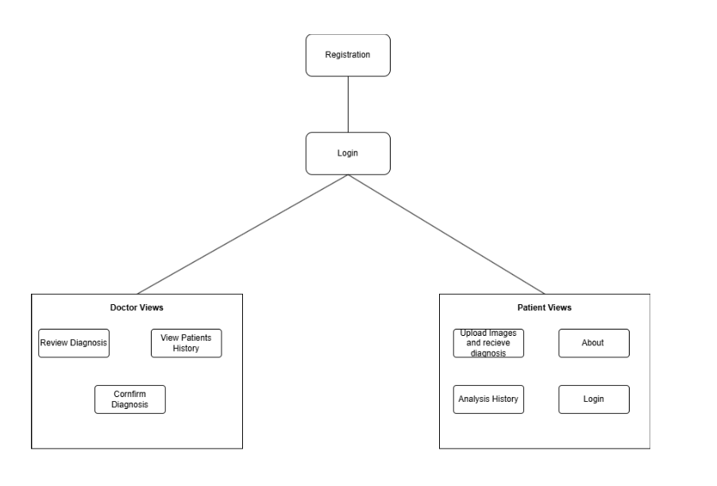
Website Architecture

Slide 9
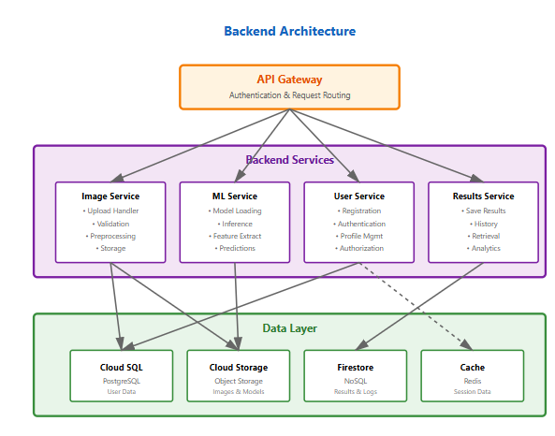
Backend Architecture

Slide 10
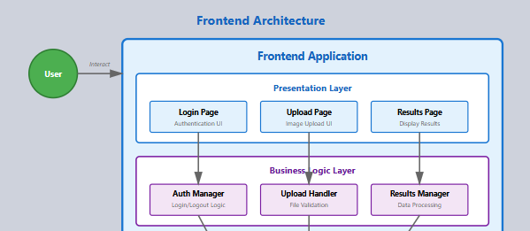
Frontend Architecture

Slide 11
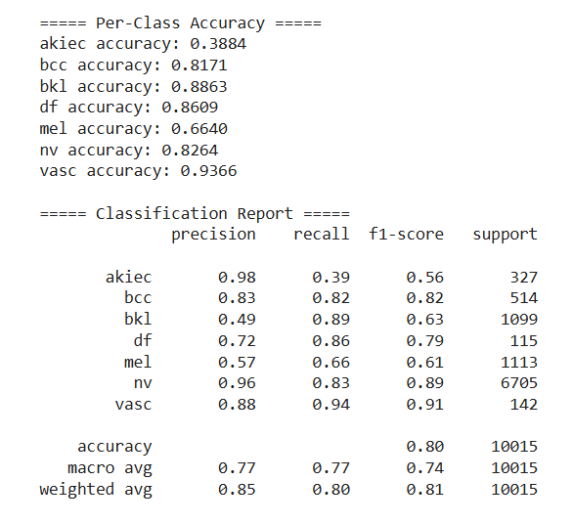
Training and Testing Model
Google Colab
Image Augmentation
Class Weighting
Splitting Dataset into Training and Validation Sets
Precision - Of predicted positives, how many were correct
Recall- Of actual positives, how many did the model find
F1-Score - Overall Performance (High Score is Good)
Support - Number of Samples in Dataset

Slide 12

Challenges
System Integration Risk
Technology Limits
Scope Creep
Other Courses
Notes:
Safeguards: Follow MoSCoW (Must, Should, Could, Won’t) priorities, discuss new ideas in team reviews, and freeze scope once MVP goals are set.

Slide 13
Project Development Plan-Milestones
Sprint 4 – December
System integration demo
Training AI with google Colab
Finalize risk assessment
Update report & presentation
Progress Front-end
Sprint 5 – January
Module Integration
MongoDB Database Integration
Training AI
Account management/login
Integrate trained AI and Expert system
Notes:
Manny(preparing the ham10000)

Slide 14
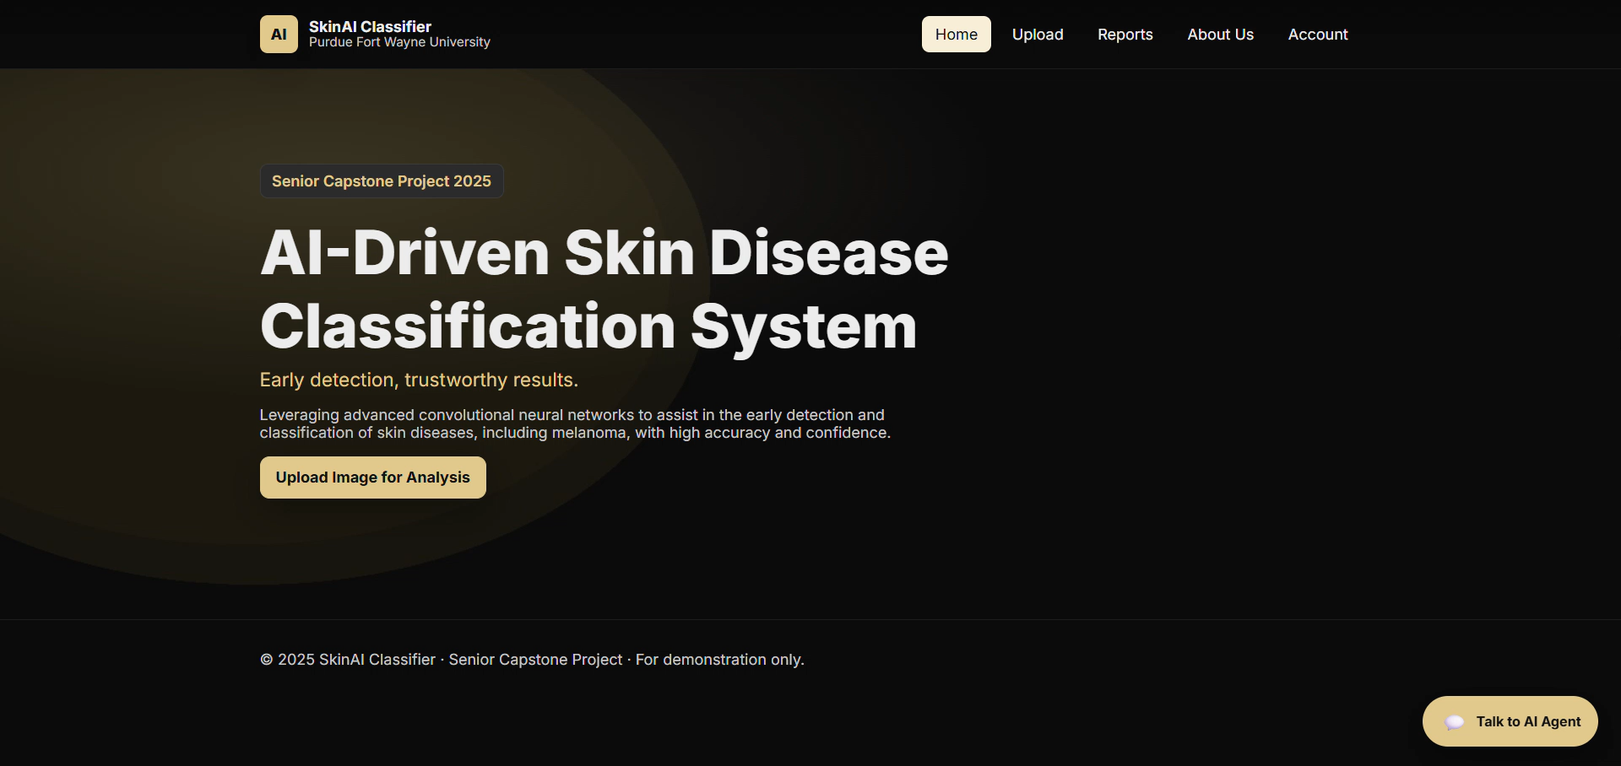

Slide 15
Thank You
Q&A?

